Slide 1
Accounting Principles, 7th Edition
Weygandt • Kieso • Kimmel
Chapter 22
Process Cost Accounting
Prepared by Naomi Karolinski
Monroe Community College
and
Marianne Bradford
Bryant College
John Wiley & Sons, Inc. © 2005

Slide 2


CHAPTER 22 PROCESS COST ACCOUNTING
After studying this chapter, you should be able to:
1 Understand who uses process cost systems.
2 Explain the similarities and differences between job order cost and process cost systems.
3 Explain the flow of costs in a process cost system.
4 Make the journal entries to assign manufacturing costs in a process cost system.
5 Compute equivalent units.

Slide 3
CHAPTER 22 PROCESS COST ACCOUNTING
After studying this chapter, you should be able to:
6 Explain the four steps necessary to prepare a production cost report.
7 Prepare a production cost report.
8 Explain just-in-time processing.
9 Explain activity-based-costing.

Slide 4
THE NATURE OF PROCESS COST SYSTEMS
STUDY OBJECTIVE 1
Process cost systems
  used to apply costs to similar products that are mass produced in a continuous fashion.
  tracked through a series of connected
  manufacturing processes or departments.

Slide 5
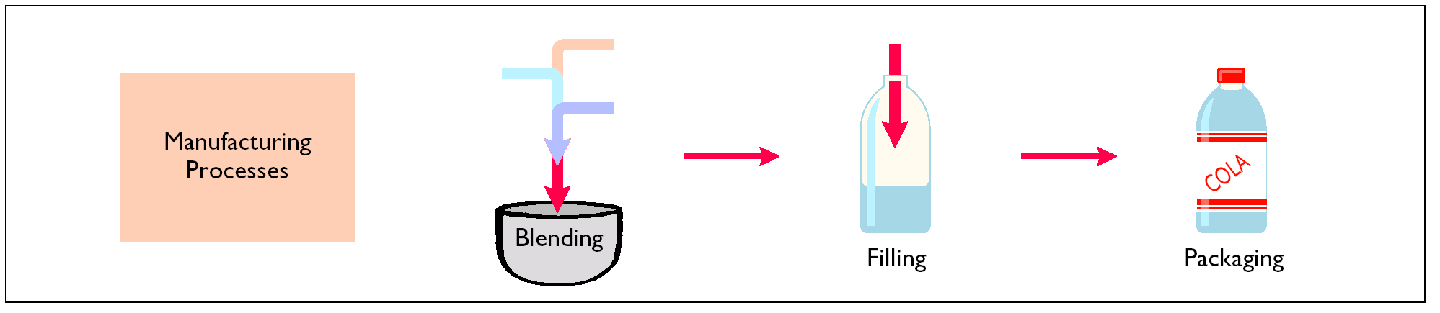
MANUFACTURING PROCESSES
A process cost accounting system is used for continuous process manufacturing, and it is necessary to record both the accumulation and assignment of manufacturing costs. A distinctive feature of process cost accounting is that individual Work in Process Inventory accounts are maintained for each production department or manufacturing process. In a beverage company, there would be a Work in Process Inventory account for each of the manufacturing processes, as illustrated below:
Notes:
3

Slide 6
In a process cost system, costs are assigned only:
a. to one work in process account.
b. to work in process and finished goods inventory.
c. to work in process, finished goods, and cost of goods sold.
d. to work in process accounts.
Chapter 22

Slide 7
In a process cost system, costs are assigned only:
a. to one work in process account.
b. to work in process and finished goods inventory.
c. to work in process, finished goods, and cost of goods sold.
d. to work in process accounts.
Chapter 22

Slide 8
SIMILARITIES BETWEEN JOB ORDER COST AND PROCESS COST SYSTEMS
STUDY OBJECTIVE 2
Job order and process cost systems are similar in three ways:
Manufacturing cost elements
Accumulation of the costs of materials, labor, and overhead
Flow of costs
  methods of assigning costs differ significantly

Slide 9
DIFFERENCES BETWEEN JOB ORDER COST AND PROCESS COST SYSTEMS
Job order and process cost systems are different in four ways:
Number of work in process accounts used.
Documents used.
Point at which costs are totaled.
Unit cost computations.

Slide 10
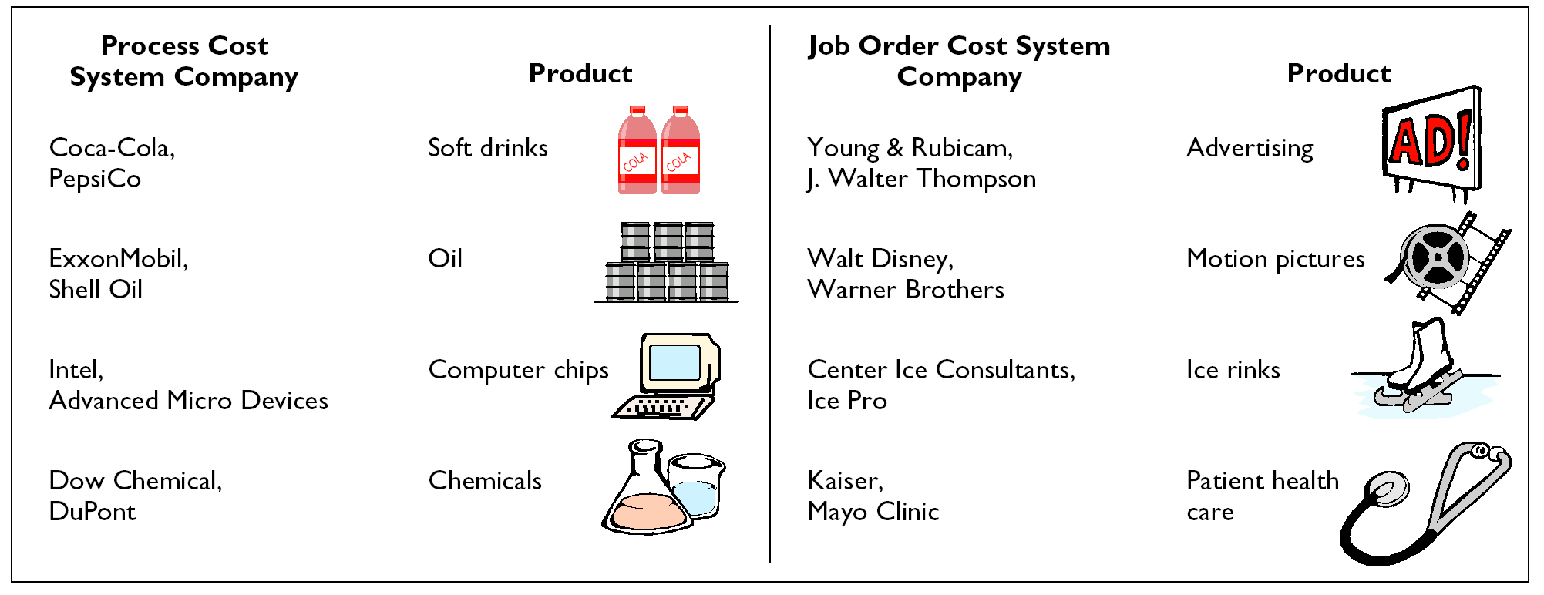
DIFFERENCES BETWEEN JOB ORDER COST AND PROCESS COST SYSTEMS

Slide 11
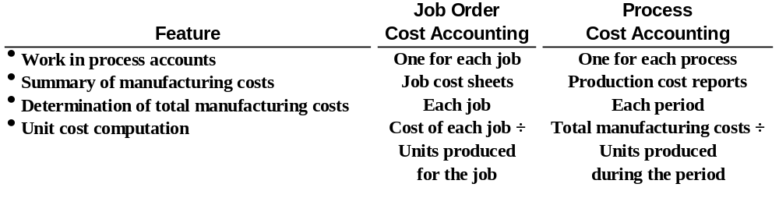
JOB ORDER VERSUS PROCESS COST ACCOUNTING
A feature of process costing is that costs charged to work in process are summarized in production cost reports.
Unit costs are calculated by dividing total manufacturing costs for the period by the units produced during the period.
The major differences between job order cost accounting and process cost accounting are summarized below:
Notes:
4

Slide 12
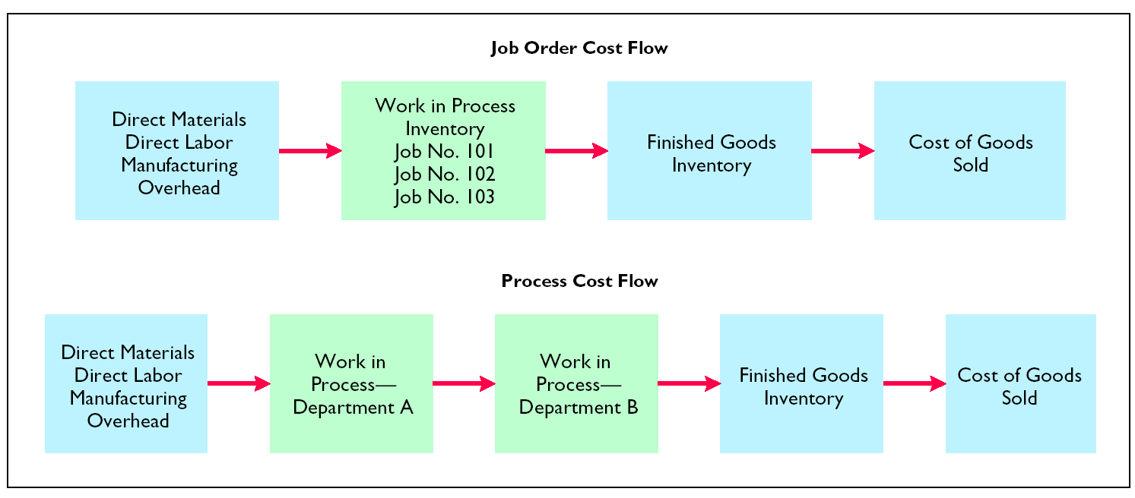
JOB ORDER VERSUS PROCESS COST ACCOUNTING

Slide 13
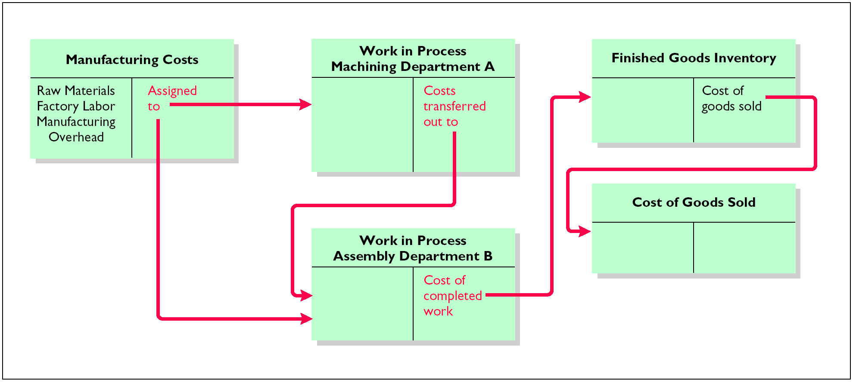
FLOW OF COSTS IN PROCESS COST SYSTEMS
STUDY OBJECTIVE 3

Slide 14
PROCESS COST FLOW ACCUMULATION OF MANUFACTURING COSTS
The accumulation of materials and labor costs is the same in process costing as in job order costing.
All raw materials are debited to Raw Materials Inventory when the materials are purchased.
All factory labor is debited to Factory Labor when the labor costs are incurred.

Slide 15
PROCESS COST FLOW ASSIGNMENT OF MATERIAL COSTS
STUDY OBJECTIVE 4
In a process cost system, fewer materials requisition slips are usually required than in a job order cost system, since materials are used for processes rather than for specific jobs.
At Hershey, materials are entered at the beginning of each process.
The entry to record the materials used during June is:
Date
Account Titles and Explanation
Debit
Credit
xxxx
xxxx
xxxx
June 30
Work in Process
–
Machining
Work in Process
–
Assembly
Raw Materials Inventory
(To record materials used)
Notes:
9

Slide 16
PROCESS COST FLOW ASSIGNMENT OF FACTORY LABOR COSTS
In process costing, as in job order costing, time tickets may be used to determine the cost of labor assignable to the production departments.
The labor cost chargeable to a process can be obtained from the payroll register or departmental payroll summaries.
The entry to assign these costs for June is:
Date
Account Titles and Explanation
Debit
Credit
xxxx
xxxx
xxxx
June 30
Work in Process
–
Machining
Work in Process
–
Assembly
Factory Labor
(To assign factory labor to production)
Notes:
17

Slide 17
PROCESS COST FLOW ASSIGNMENT OF MANUFACTURING
OVERHEAD COSTS
In process cost accounting, the objective in assigning overhead is to allocate the overhead costs to the production departments on an objective and equitable basis.
That basis is the activity that “drives” or causes the costs.
A primary driver of overhead costs in continuous manufacturing operations is machine time used, not direct labor.
The entry to allocate overhead for June to the two processes is:
Date
Account Titles and Explanation
Debit
Credit
June 30
Work in Process
xxxx
xxxx
xxxx
–
Machining
Work in Process
–
Assembly
Manufacturing Overhead
(To assign overhead to processes)

Slide 18
PROCESS COST FLOW TRANSFER TO NEXT DEPARTMENT
At the end of June, an entry is needed to record the cost of the goods transferred out of the Machining Department.
The transfer is to the Assembly Department and the following entry is made:
Date
Account Titles and Explanation
Debit
Credit
June 30
Work in Process
xxxx
xxxx
–
Assembly
Work in Process
–
Machining
(To record transfer of units to the Assembly
Department)

Slide 19
PROCESS COST FLOW TRANSFER TO FINISHED GOODS
The units completed in the Assembly Department during June are transferred to the finished goods warehouse.
The entry for this transfer is as follows:
Date
Account Titles and Explanation
Debit
Credit
June 30
Finished Goods Inventory
xxxx
xxxx
Work in Process
–
Assembly
(To record transfer of units to finished goods)

Slide 20
PROCESS COST FLOW TRANSFER TO COST OF GOODS SOLD
The entry to record the cost of goods sold during June is as follows:
Date
Account Titles and Explanation
Debit
Credit
June 30
Cost of Goods Sold
xxxx
xxxx
Finished Goods Inventory
(To record cost of units sold)

Slide 21
END-OF-PERIOD PROCEDURES MACHINING DEPARTMENT
By the end of the period Hershey has accumulated the materials, labor, and overhead costs in each production department’s Work in Process account.
These accumulated costs must now be assigned to
the units transferred out of each department and
the units in the ending Work in Process in each department.
The procedures used in calculating and assigning the costs present the most difficult challenge to your understanding of process cost accounting.
Notes:
27

Slide 22
EQUIVALENT UNITS
STUDY OBJECTIVE 5
Equivalent units of production
  the work done during the period on the physical units of output, expressed in terms of fully completed units.
  are determined by applying the percentage of work done to the physical units of output.
Equivalent units are the sum of the work performed to:
Finish the units of beginning work in process inventory.
Complete the units started into production during the period.
Start, but only partially complete, the units in ending work in process inventory.

Slide 23
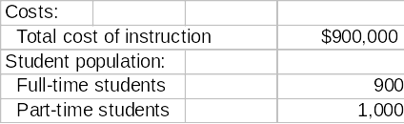
INFORMATION FOR FULL-TIME STUDENT EXAMPLE
Suppose you were asked to compute the cost of instruction at your college per full-time equivalent student. You are provided with the following information.
Part-time students take 60 percent of the classes of a full-time student during the year.
To compute the number of full-time equivalent students per year, you would make the following computation:

Slide 24
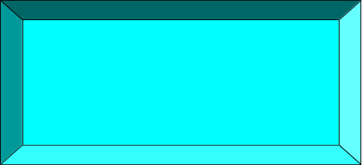
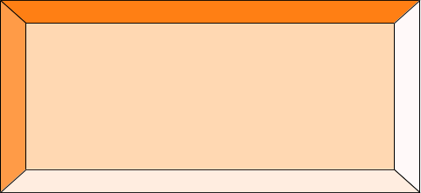
FULL-TIME EQUIVALENT UNIT
COMPUTATION
Equivalent Units of Part-time
Students
Full-time
Equivalent Students
Full-time
Students
+ =
900 + (60% x 1,000) = 1,500
The cost of instruction per full-time equivalent student is therefore
the total cost of instruction ($900,000) divided by the number of
full-time equivalent students (1,500), which is $600 ($900,000/1,500).

Slide 25
EQUIVALENT UNITS
OF PRODUCTION FORMULA
Units Completed and Transferred Out
Equivalent Units of Ending Work
in Process
Equivalent Units
of production
+ =
The formula to compute equivalent units of production is shown above.
This method of computing equivalent units is referred to as the weighted
average method. It considers the degree of completion (weighting) of the
units completed and transferred out and the ending work in process.
It is the method most widely used in practice.

Slide 26
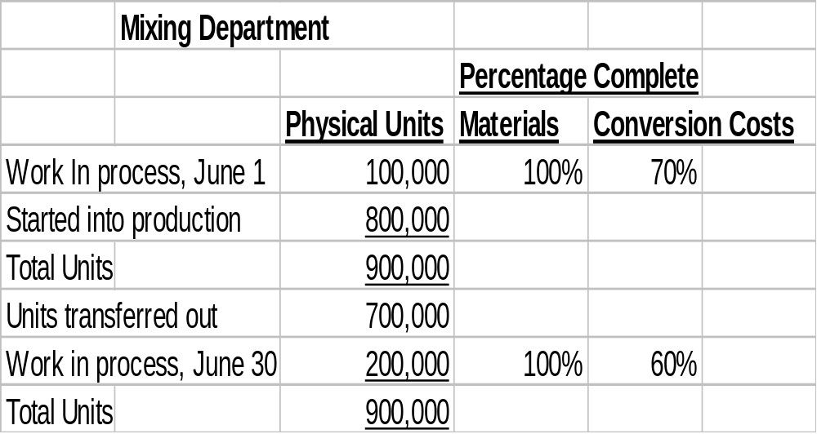
INFORMATION FOR
MIXING DEPARTMENT
Assume the beginning work in process is 100% complete as to materials cost
and 70% complete as to conversion costs. The ending work in process is
100% complete as to materials cost and 60% complete as to conversion cost.

Slide 27
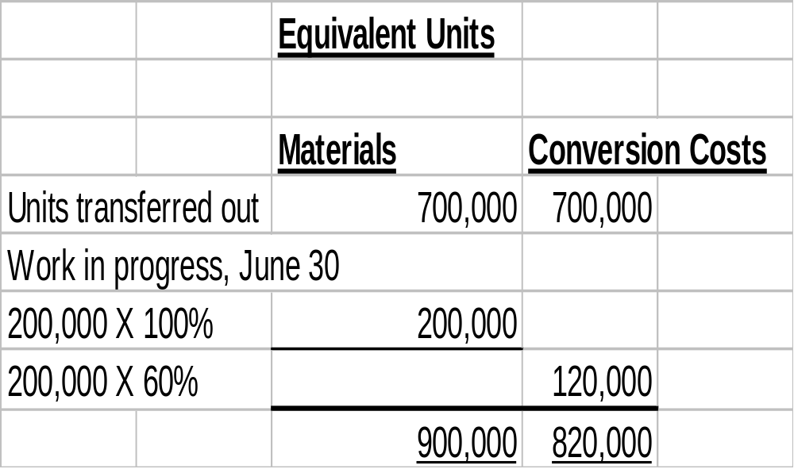
COMPUTATION OF EQUIVALENT UNITS
MIXING DEPARTMENT
In computing equivalent units, the beginning work in process is not part of the equivalent units of production formula. The units transferred out to the Baking Department are fully complete as to both materials and conversion costs. The ending work in process is fully complete as to materials, but only 60% complete as to conversion costs.
Two equivalent unit computations are therefore necessary.

Slide 28
REFINED EQUIVALENT UNITS
OF PRODUCTION FORMULA
Units Completed and Transferred Out-Materials
+
Equivalent Units of Ending Work
in Process-Materials
Equivalent Units
of Production-Materials
=
Units Completed and Transferred Out-
Conversion Costs
+
Equivalent Units of Ending Work
in Process-Materials-
Conversion Costs
Equivalent Units
of Production-Conversion Costs
=
The earlier formula used to compute equivalent units of production can
be refined to show the computations for materials and for conversion
costs as shown above.

Slide 29
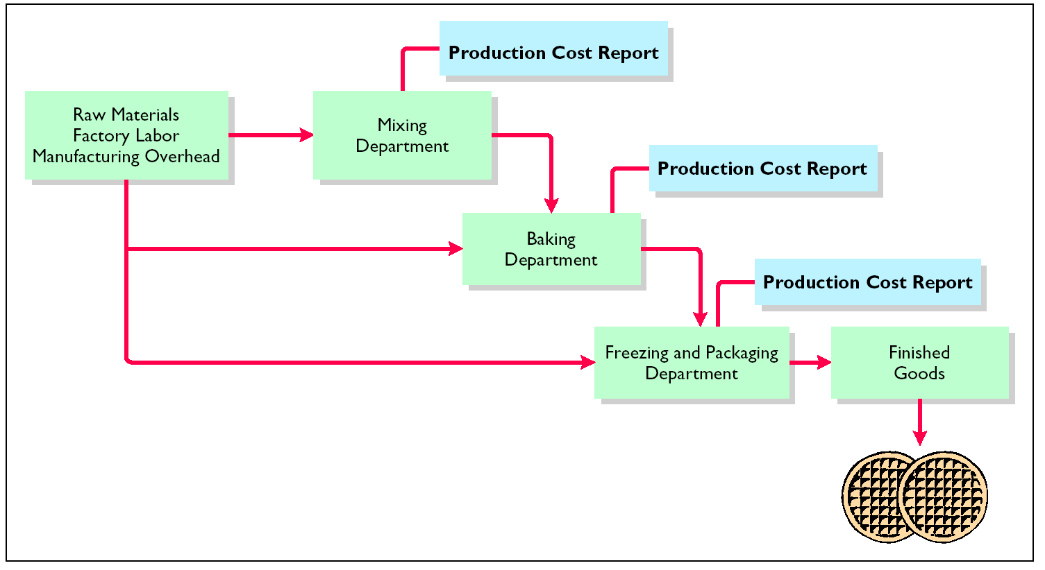
FLOW OF COSTS IN MAKING
EGGO WAFFLES

Slide 30
END-OF-PERIOD PROCEDURES MACHINING DEPARTMENT
For each process, it is necessary to perform the following procedures at the end of the period:
1 Calculate the physical units.
2 Calculate equivalent units of production.
3 Calculate unit costs of production.
4 Assign costs to the units transferred and in process.
5 Prepare the production cost report.
Notes:
Not in the chapter.

Slide 31
COMPREHENSIVE EXAMPLE OF PROCESS COSTING
STUDY OBJECTIVE 6
Data for the Mixing Department at Eggo Waffles for the month of June are shown on the next slide. The data will be used to complete a production cost report for the Mixing Department.

Slide 32
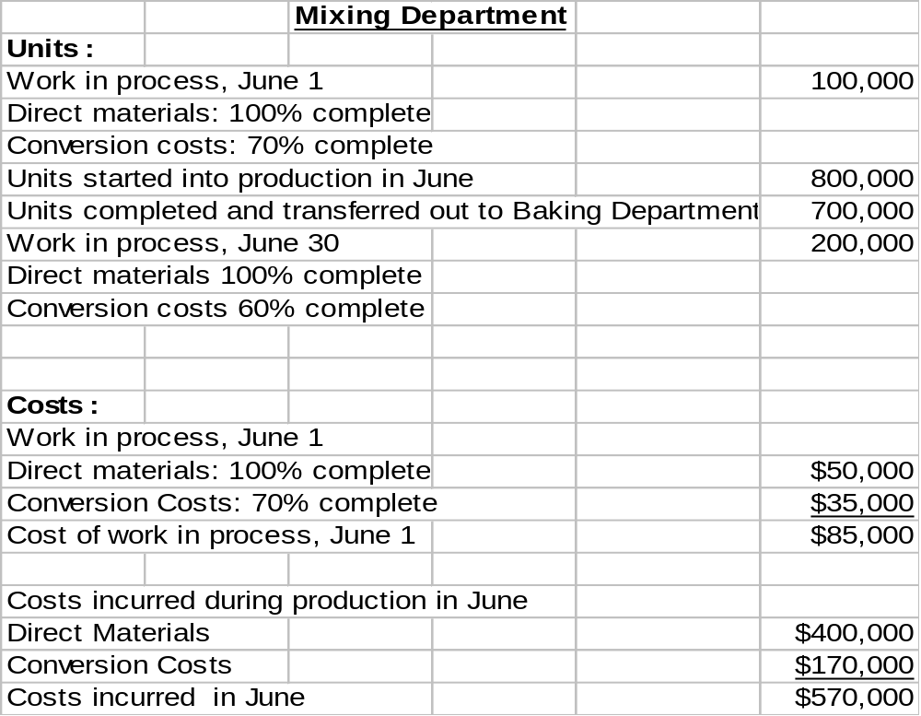
UNIT & COST DATA
MIXING DEPARTMENT

Slide 33
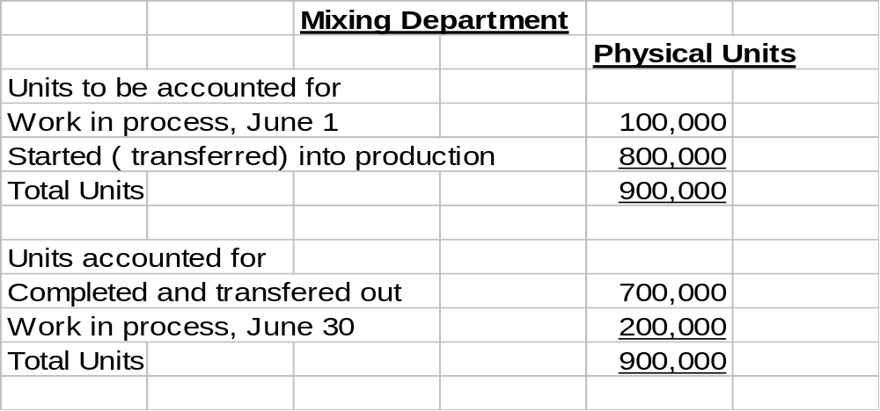
PHYSICAL UNIT FLOW-
MIXING DEPARTMENT –STEP 1
Physical units are the actual units to be accounted for during
a period, irrespective of any work performed. To keep track
of these units, it is necessary to add the units started (or
transferred) into production during the period to the units in
process at the beginning of the period. This amount is
referred to as the total units to be accounted for. In the Mixing Department, 900,000 units must be accounted for.

Slide 34
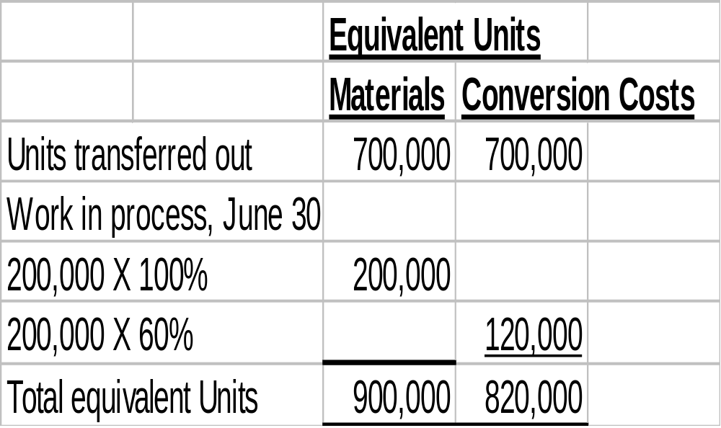
COMPUTATION OF EQUIVALENT UNITS
MIXING DEPARTMENT-STEP 2
Once the physical flow of the units is established, it is necessary
to measure the Mixing Department’s productivity in terms of
equivalent units of production. The equivalent unit computation
is as follows:

Slide 35
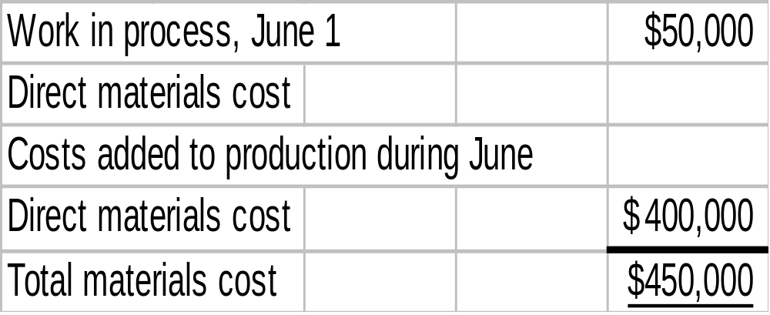
MATERIALS COST COMPUTATION-STEP 3
Unit production costs are costs expressed in terms of equivalent
units of production. When equivalent units of production are
different for materials and conversion costs, three unit costs are
computed: (1) materials, (2) conversion, and (3) total manufacturing.
The computation for Eggo Waffles is as follows:

Slide 36
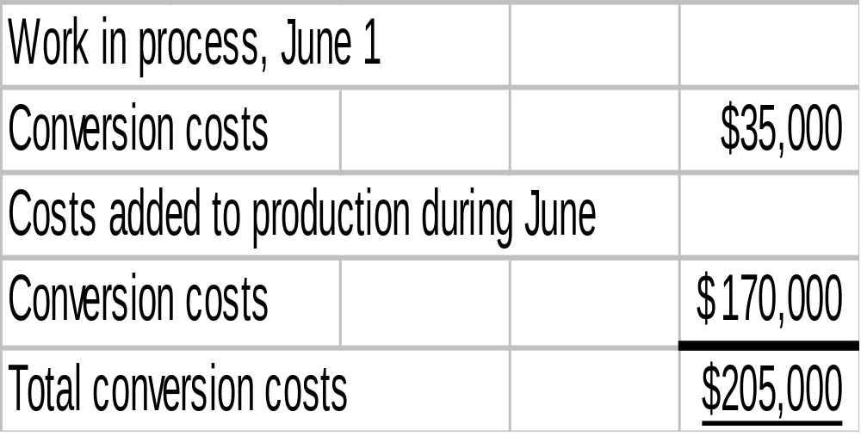
CONVERSION COSTS
COMPUTATION
The computation of total conversion costs is as follows:

Slide 37
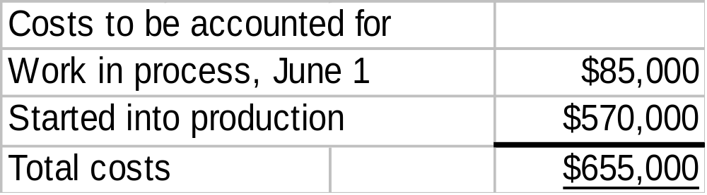
COSTS CHARGED TO MIXING DEPARTMENT – STEP 4
The total costs that were charged to the Mixing Department
in June are as follows:

Slide 38
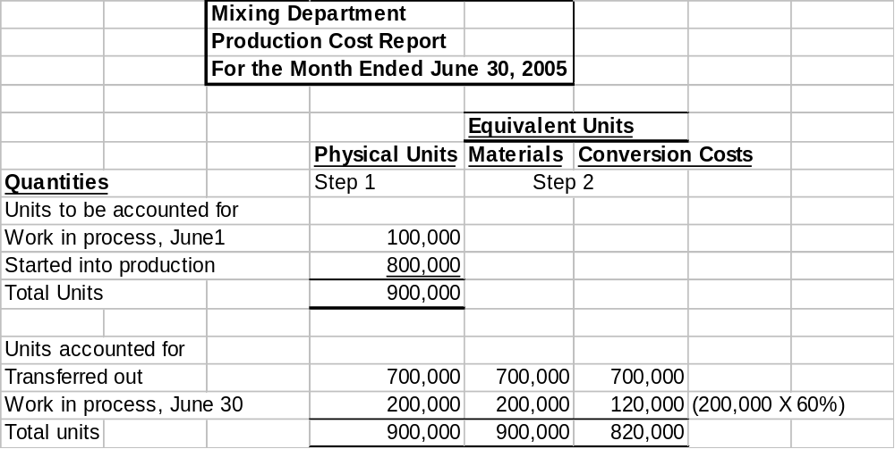
PRODUCTION COST REPORT
STUDY OBJECTIVE 7

Slide 39
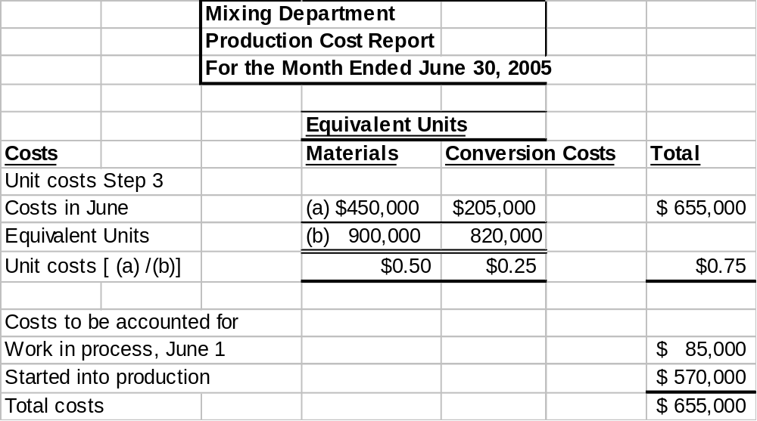
PRODUCTION COST REPORT

Slide 40
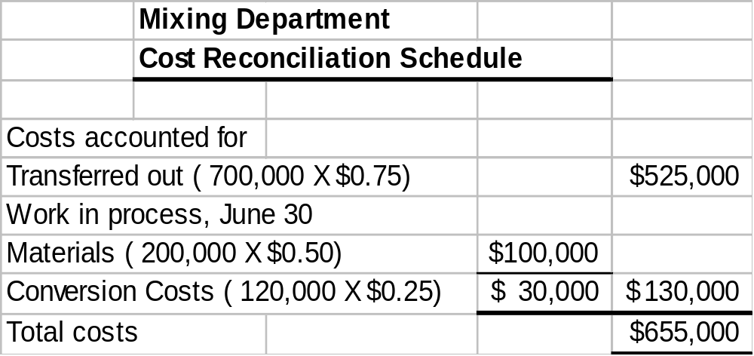
COST RECONCILIATION SCHEDULE
MIXING DEPARTMENT
The total costs charged to the Mixing Department in June are
therefore $655,000. A cost reconciliation schedule is then
prepared to assign the costs to (1) units transferred out to the
Baking Department and (2) ending work in process.

Slide 41



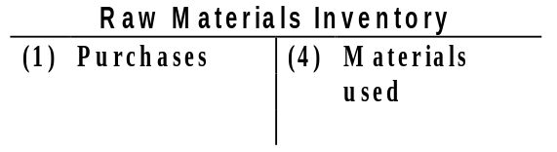
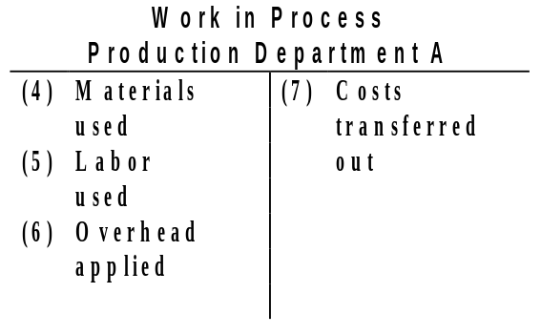
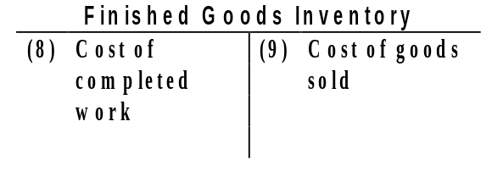
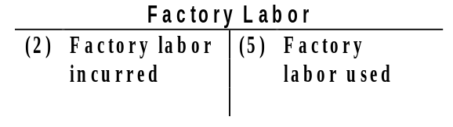
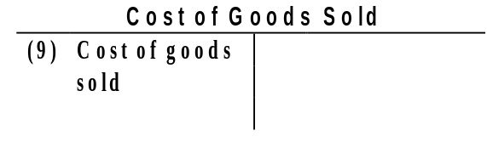

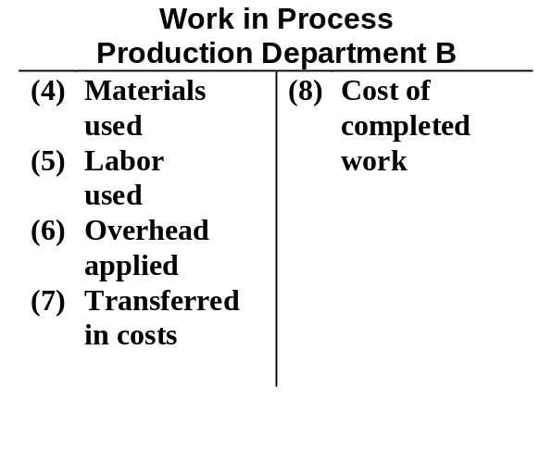
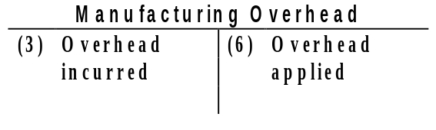
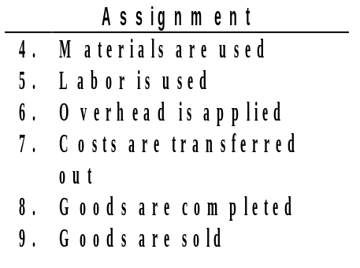
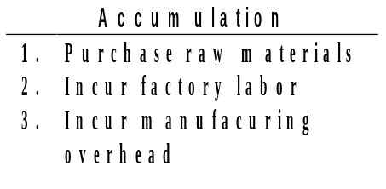
FLOW OF COSTS IN
PROCESS COST ACCOUNTING
Process Cost Accounting
4
9
7
5
6
Key to Entries:
8
Key to Entries:
Notes:
5
Not in the chapter

Slide 42
The cost reconciliation schedule shows that the total:
a. units to be accounted for equal the total units accounted
for.
b. costs accounted for equal the total costs to be accounted for.
c. units to be accounted for equal the total costs to be
accounted for.
d. costs accounted for equal the total units accounted for.
Chapter 22

Slide 43
The cost reconciliation schedule shows that the total:
a. units to be accounted for equal the total units accounted
for.
b. costs accounted for equal the total costs to be accounted for.
c. units to be accounted for equal the total costs to be
accounted for.
d. costs accounted for equal the total units accounted for.
Chapter 22

Slide 44
CONTEMPORARY DEVELOPMENTS JUST-IN-TIME PROCESSING
STUDY OBJECTIVE 8
Primary objective:
    Eliminate all manufacturing inventories.
    Inventories can have an adverse effect on net income because of their high storage and maintenance costs.
There are 3 important elements:
  Dependable suppliers
  Multi-skilled work force
  A total quality control system

Slide 45

CONTEMPORARY DEVELOPMENTS JUST-IN-TIME PROCESSING
Major Benefits:
Manufacturing inventories significantly reduced or eliminated.
Product quality enhanced.
Rework costs and inventory storage costs reduced or eliminated.
Production cost savings are realized from the improved flow of goods through the processes.

Slide 46
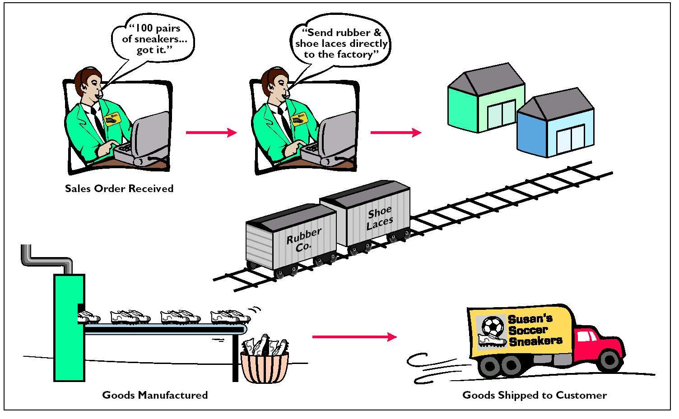
JUST-IN-TIME PROCESSING

Slide 47
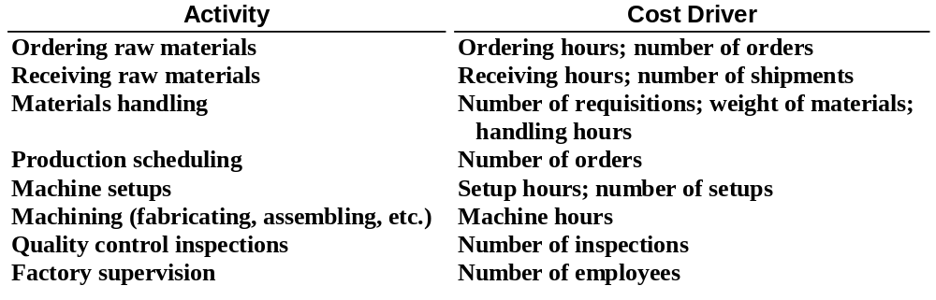
ACTIVITIES AND COST DRIVERS IN ABC
STUDY OBJECTIVE 9
Activity-based costing (ABC) focuses on the activities performed in producing a product. In ABC, the cost of a product is equal to the sum of the costs of all activities performed to manufacture it.

Slide 48

CONTEMPORARY DEVELOPMENTS ACTIVITY-BASED COSTING
Two important assumptions must be met in order to obtain accurate product costs under ABC:
All overhead costs related to the activity must be driven by the cost driver used to assign costs to products.
All overhead costs related to the activity should respond proportionally to changes in the activity level of the cost driver.

Slide 49

COPYRIGHT
Copyright © 2005 John Wiley & Sons, Inc. All rights reserved. Reproduction or translation of this work beyond that permitted in Section 117 of the 1976 United States Copyright Act without the express written consent of the copyright owner is unlawful. Request for further information should be addressed to the Permissions Department, John Wiley & Sons, Inc. The purchaser may make back-up copies for his/her own use only and not for distribution or resale. The Publisher assumes no responsibility for errors, omissions, or damages, caused by the use of these programs or from the use of the information contained herein.

